Slide 1

Song Debut Data Analysis of the Billboard Hot 100
Samantha Cabral
DSC 530 - Data Exploration and Analysis
Prof. Metzger
Due: November 17, 2024
Final Term Project

Slide 2
Data Set & Statistical Question
Data set includes the weekly Billboard Hot 100 songs, which are the top 100 songs each week according to the Billboard Chart
Data Set found on Kaggle
Statistical Question: Do songs that debut in the top 10 stay on the Billboard Hot 100 chart longer than songs that debut between ranks 11 and 100?

Slide 3
Variables
‘debut_rank’ – the debut_rank variable specifies the rank at which a song on the Hot 100 chart debuted
‘final_rank’ – the final_rank variable specifies the rank at which a song spent its last week on the Hot 100 chart
‘peak_rank’ – this variable tells us the highest rank a song earned during its tenure on the Hot 100 chart (different than peak-rank from data set.
‘top10_longevity’ – the count of how many weeks songs that debut in the top 10 stay on the Hot 100 chart
‘bottom90_longevity’ – the count of how many weeks songs that debut between 11 and 100 stay on the Hot 100 chart

Slide 4
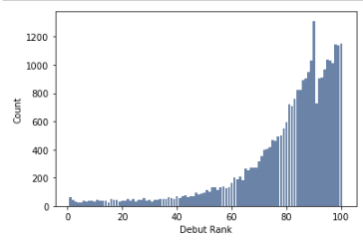
Variables: ‘debut_rank’
This histogram shows the rank for a song on its debut week on the Hot 100 chart
This histogram is skewed left and shows how songs aren’t very likely to debut in in the top 10. Surprisingly, the likelihood of debuting in the top 40 is similar to the likelihood of debuting in the top 10.
An outlier seems to exist at around the 90th debut_rank, but based on the other data points, it is unlikely that this is due to any errors in the data.

Slide 5
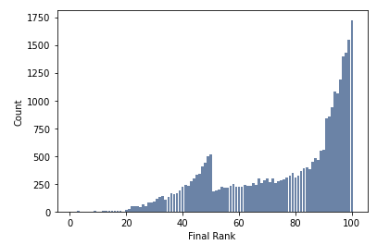
Variables: ‘final_rank’
This histogram shows the rank for a song on its final week on the Hot 100 chart
This histogram is skewed left and shows that songs are more likely to spend their last week near the bottom of the Hot 100 chart.
The histogram shows an unexpected amount of songs spend their final week on the chart ranked near 50th, then it drops and begins peaking again near 100. It is hard to explain the reasoning behind this data at this time.

Slide 6
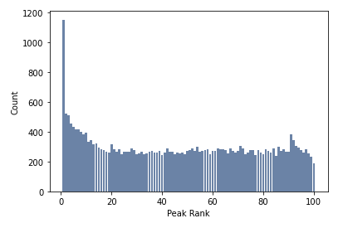
Variables: ‘peak-rank’
This histogram shows the peak-rank information for all songs that enter the Hot 100 chart
This histogram is skewed right and shows that there are many songs that have hit #1 during its tenure on the Hot 100 chart.
An outlier seems to be the number of songs that peak at #1 is much higher than expected based on the overall distribution

Slide 7
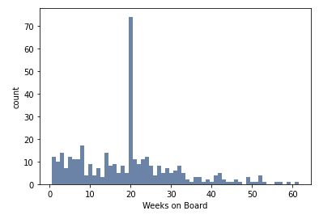
Variables: ‘top10_longevity’
This histogram shows the longevity of a song that debuts between #1 and #10 on the Hot 100 chart.
This histogram is relatively uniform or slightly skewed right and doesn’t show that songs that chart between #1 and #10 have longevity, otherwise it would be more left skewed.
The obvious outlier is at the 20-week mark, which is occurring much more often than expected based on the distribution. I’d like to explore the reason for outliers in count at 20 weeks.

Slide 8
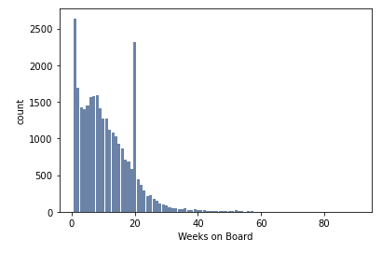
Variables: ‘bottom90_longevity’
This histogram shows the longevity of a song that debuts between #11 and #100 on the Hot 100 chart.
This histogram is right skewed, demonstrating that songs that debut between #11 and #100 are unlikely to have longevity on the Hot 100 chart.
There are a few different outliers. This histogram shows many songs only last one week, many last 20 weeks, and there are a few songs that may last close to 80 weeks. I’d like to explore the reason for outliers in counts at 20 weeks.

Slide 9
Summary Statistics: Variables
Summary Statistic | debut_rank | final_rank | peak_rank | top10_longevity | bottom90_longevity
Mean | 80.239 | 76.572 | 46.608 | 19.420 | 11.036
Mode | 90 | 100 | 1 | 20 | 1
Spread (std_dev) | 19.271 | 21.674 | 30.569 | 12.313 | 8.220
Tail (skew) | -1.795 | -0.722 | 0.080 | 0.762 | 1.326

Slide 10
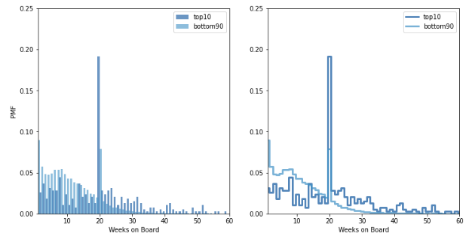
Probability Mass Function (PMF)
Top 10 vs Bottom 90 Longevity (in weeks)
PMF, or Probability Mass Function, “maps from each value to its probability (Downey, 2014).”
The PMF plotted shows the probability of songs lasting a number of weeks based on the song’s debut rank
Top10 represents songs that debut between #1 and 10 on the chart
Bottom 90 represents songs that debut between #11 and 100 on the chart.

Slide 11
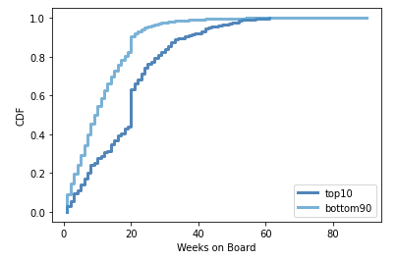
Cumulative Distribution Function (CDF)
Top 10 vs Bottom 90 Longevity (in weeks)
CDF, or Cumulative Distribution Function is the function that maps from a value to its percentile rank.
The CDF plotted shows the percentile rank for a song’s longevity in weeks
According to the CDF, about 50% of top10 songs will remain on the Hot 100 for about 21 weeks or less. It also shows that 50% of bottom90 songs will remain on the Hot 100 for about 15 weeks or less.
The CDF comparison shows that there is some truth to the statement that the top 10 songs are more likely to remain on the Hot 100 chart longer than songs that debut at any other rank.

Slide 12
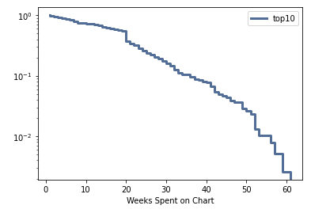
Exponential Analytic Distribution
Top 10 Longevity
CCDF, or complementary cumulative distribution function plot can be used to determine if data follows an exponential distribution.
The CCDF plotted is not exactly straight, “which indicates that the exponential distribution is not a perfect model for the data (Downey, 2014).”
This may mean that songs that debut in the top 10 may not have longevity on the Hot 100 chart

Slide 13
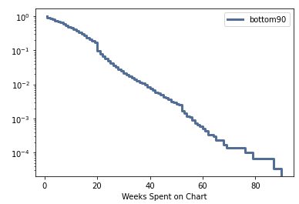
Exponential Analytic Distribution
Bottom 90 Longevity
The CCDF plotted is much straighter, indicating that the exponential distribution is a more perfect model suited for the songs that debut in the bottom 90.
This may mean that songs that debut in the bottom 90 may not have longevity on the Hot 100 chart and the likelihood of a song staying on the chart doesn’t depend on how long it has already been there, which matches a property called memorylessness, where the “past has no bearing on its future (Myers, n.d.).”

Slide 14
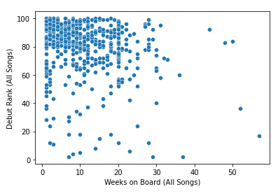
Scatterplot Comparing Debut Rank and Weeks on Board
Using a sample of 500 songs from the Hot 100, this scatterplot visualizes a comparison between the song’s Debut Rank and Weeks on Board.
This scatterplot shows that songs with high debut ranks (closer to 100) tend to spend less time on the chart. There is a negative correlation between debut rank and final rank.
There may be an indication that songs with better debut ranks have a higher longevity on the chart.
There are outliers that show songs with debut ranks at around 50, for example, have an unexpectedly long chart life. Causation may be due to popularity gain over time.
Pearson’s correlation is -0.202, showing a weak negative relationship between debut rank and weeks on board.

Slide 15
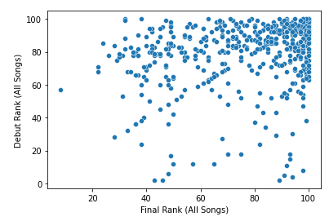
Scatterplot Comparing Debut Rank and Final Rank
Using a sample of 500 songs from the Hot 100, this scatterplot visualizes a comparison between the song’s Debut Rank and that son’s Final Rank, no matter the longevity of the song.
This scatterplot shows that songs with low debut ranks (closer to 100 on the y axis) tend to exit the chart with a low final rank. This shows a negative correlation.
The variation shows that some songs enter the chart ranked low and climb the chart. I believe the causation is related to the timing of song releases, where songs released closer to chart releases have less time for people to search them up and listen to them.
The Pearson’s Correlation is 0.176, which is a weak positive correlation.

Slide 16
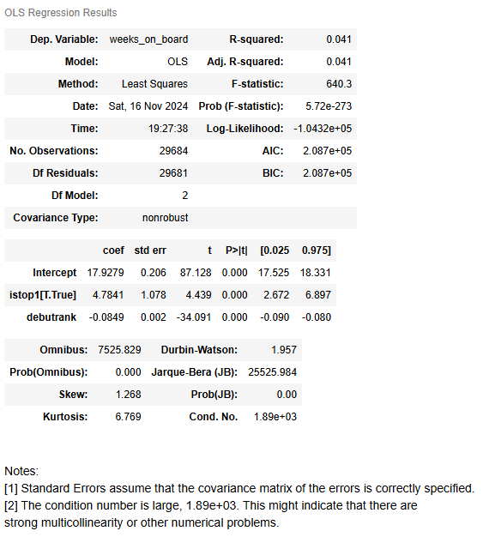
Multiple Regression Analysis: Predict Weeks-On-Board with Debut-Rank and ‘isTop1’
R-squared value explains 4.1% variation in weeks on the chart
Low R-squared value, while statistically significant, suggests that predictors istop10 and debutrank only explain a small part of the story.
Intercept is just a reference point for this data set, since debutranks start at 1
Average number of weeks a song lives on the chart is 17.9 weeks
P-value close to 0 supports my hypothesis that songs debuting closer to rank 1 tend to stay longer on the chart, but only with a small effect as shown by the modest coefficient.

Slide 17
References
Downey, A. B. (2014). Think Stats: Exploratory Data Analysis in Python Version 2. O’Reilly Media, Inc.
Myers, D. (n.d.). CS 547 Lecture 9: Conditional Probabilities and the Memoryless Property. https://pages.cs.wisc.edu/~dsmyers/cs547/lecture_9_memoryless_property.pdf

